Slide 1
TOTAL QUALITY MANAGEMENT(TQM)
Session 41

Slide 2
Total quality management (TQM) is the continual process of detecting and reducing or eliminating errors in manufacturing, streamlining supply chain management, improving the customer experience, and ensuring that employees are up to speed with training.
Total quality management aims to hold all parties involved in the production process accountable for the overall quality of the final product or service.
The focus of the process is to improve the quality of an organization's outputs, including goods and services, through continual improvement of internal practices

Slide 3
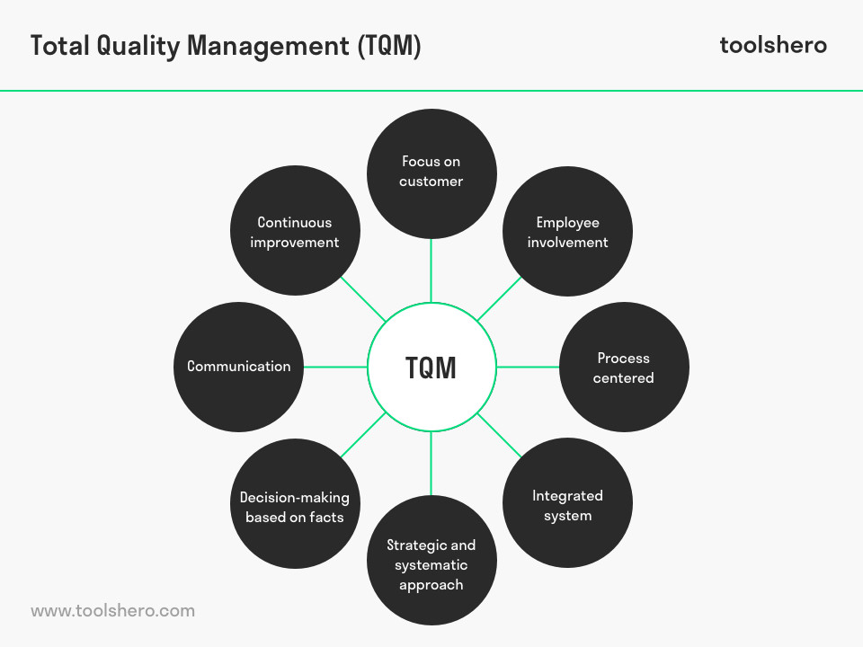
TQM PRINCIPLES

Slide 4
benefits OF tqm
The major benefits of TQM in terms of cost savings include: elimination of non-confirmation and repetitive work, elimination of waste costs and reject products, elimination of repairs and reworks.

Slide 5
What Are Some of the Companies That Benefited From TQM?

Slide 6
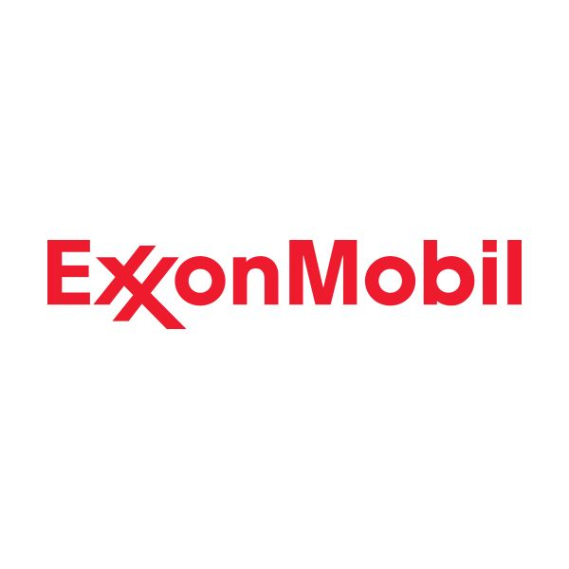
Exxon Used TQM to Re-Brand

Slide 7
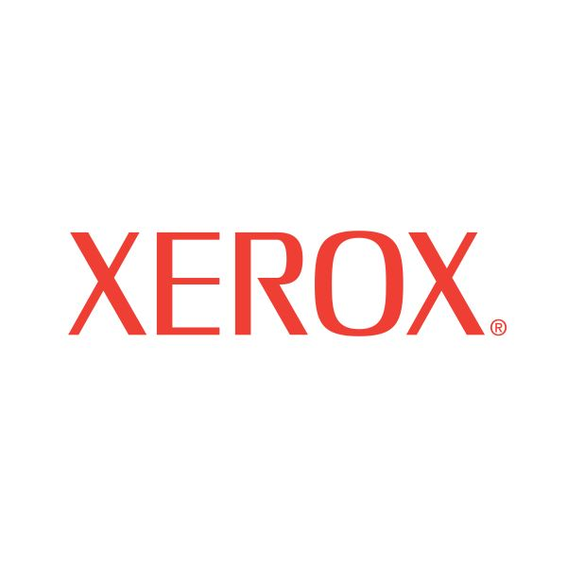
Xerox Fights Back With TQM

Slide 8
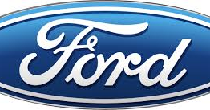
Ford is Driven by TQM

Slide 9
Lean manufacturing
Lean provides tools and processes to eliminate waste from the manufacturing process resulting in improved efficiency, effectiveness, and profitability.

Slide 10
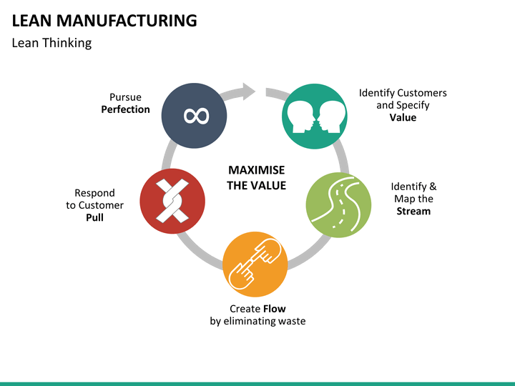

Slide 11
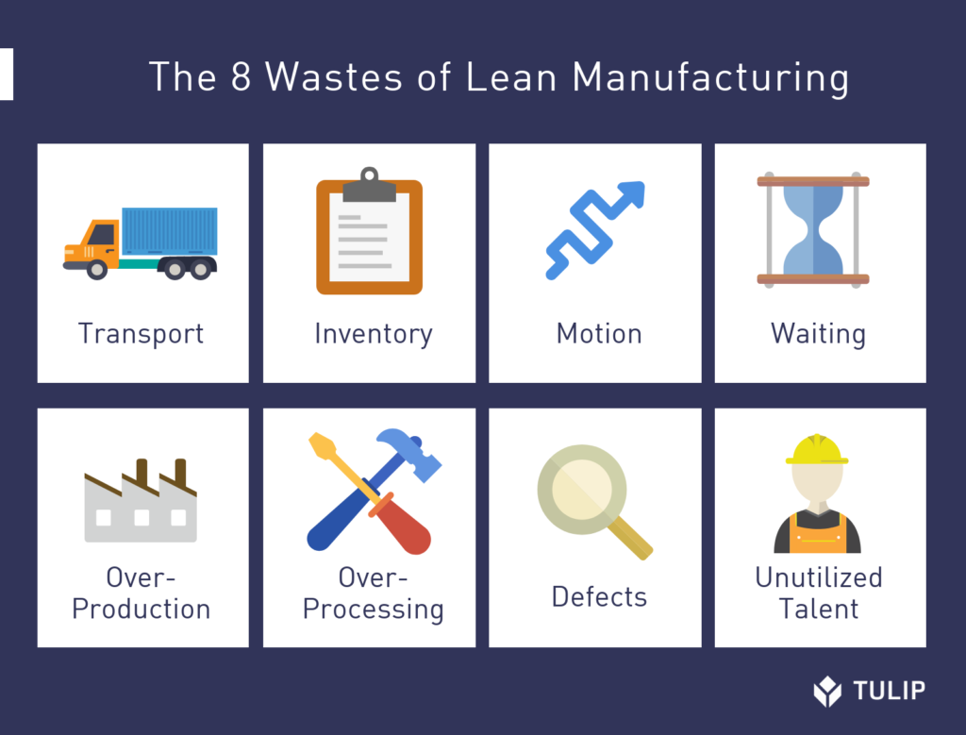

Slide 12
Supply chain management
Supply chain management is the management of the flow of goods and services and includes all processes that transform raw materials into final products. It involves the active streamlining of a business's supply-side activities to maximize customer value and gain a competitive advantage in the marketplace.

Slide 13
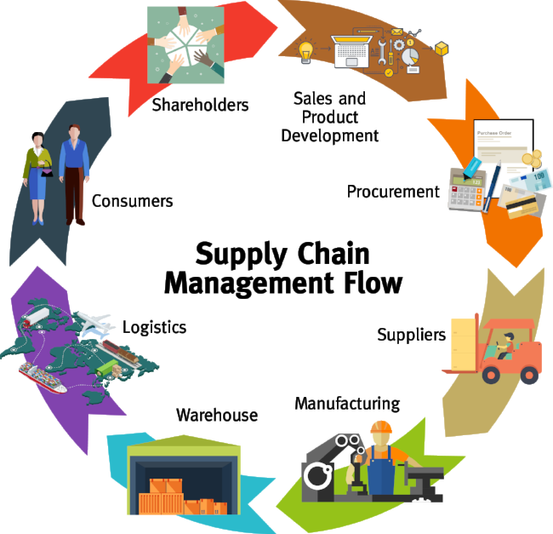

Slide 14
Value chain management
The process of organizing the connected group of activities that create value by producing goods or services from basic raw materials for purchase by a consumer.
The basic objectives of employing value chain management in a business is to integrate communication and increase cooperation between production chain members in order to decrease delivery times, reduce inventories and increase customer satisfaction.

Slide 15
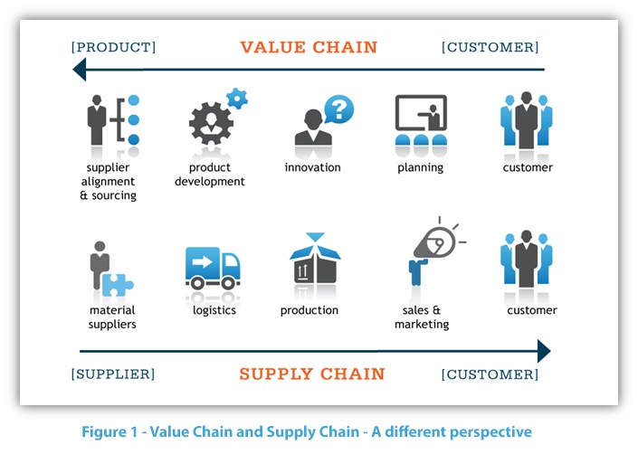

Slide 16
Value chain process model
Porter’s value chain is a framework for developing an analytic structure that follows interdependent activities from raw material acquisition or idea through production and finally, into the hands of a customer. This model is as useful today as it was over 30 years ago because businesses in all industries have the ability to identify alliances or linkages between the discrete activities that contribute to their product development.
Porter’s value chain involves five primary activities: inbound logistics, operations, outbound logistics, marketing and sales, and service. Support activities are illustrated in a vertical column over all of the primary activities. These are procurement, human resources, technology development, and firm infrastructure

Slide 17
